Slide 1
Application Insights
Anju munoth

Slide 2
Azure Application Insights
Azure Monitor Application Insights is an OpenTelemetry feature of Azure Monitor that offers application performance monitoring (APM) for live web applications.
Integrating with OpenTelemetry (OTel) provides a vendor-neutral approach to collecting and analyzing telemetry data, enabling comprehensive observability of your applications.
Application Insights supports OpenTelemetry (OTel) to collect telemetry data in a standardized format across platforms.
Integration with Azure services allows for efficient monitoring and diagnostics, improving application observability and performance.

Slide 3
Azure Application Insights
Powerful cloud-based service provided by Microsoft that helps developers to monitor and diagnose the performance of their applications.
Part of the Azure Monitor family of services that provide end-to-end monitoring solutions for applications, infrastructure, and networks.
With Application Insights, developers can gain valuable insights into how their applications are behaving in real-time, identify performance issues, and troubleshoot problems quickly.

Slide 4
Azure Application Insights?
Cloud-based monitoring and diagnostics service that helps developers to detect and diagnose issues in their applications.
Designed to help developers gain a deeper understanding of their application’s performance and user behavior by collecting telemetry data from various sources, including web servers, client devices, and other application components.
Provides a comprehensive set of tools and features that enable developers to monitor various aspects of their applications, such as performance, availability, usage, and exceptions.
Provides real-time insights into how users are interacting with their applications, including metrics on user engagement, retention, and conversion rates.

Slide 5
Key Features of Azure Application Insights
Application Performance Monitoring (APM)
Application Insights offers end-to-end APM capabilities, enabling developers to monitor the performance of their applications in real-time.
Tracks the performance of various application components, including web requests, database queries, and external dependencies.
Provides insights into application exceptions, such as crashes and errors, enabling developers to identify and resolve issues quickly.

Slide 6
Key Features of Azure Application Insights
User Analytics
Application Insights provides powerful user analytics capabilities that enable developers to gain insights into how users are interacting with their applications.
Tracks user behavior, including user flows, user sessions, and user retention.
Provides insights into user demographics, such as location, device type, and operating system.

Slide 7
Key Features of Azure Application Insights
Custom Telemetry
Application Insights supports custom telemetry, enabling developers to log custom events and metrics in their applications.
Useful for tracking custom business metrics, such as conversion rates and user engagement.

Slide 8
Key Features of Azure Application Insights
Integration with DevOps Tools
Application Insights integrates with various DevOps tools, such as Visual Studio, Azure DevOps, and GitHub.
This integration enables developers to gain insights into their application’s performance and behavior directly from their development environment.

Slide 9
Key Features of Azure Application Insights
Alerting and Notification
Application Insights provides alerting and notification capabilities that enable developers to get notified when their application’s performance or behavior deviates from predefined thresholds.
Supports various notification channels, such as email, SMS, and webhook.

Slide 10
Key Features of Azure Application Insights
Log Analytics Integration
Application Insights integrates with Azure Log Analytics, enabling developers to combine log data with telemetry data to gain a deeper understanding of their application’s behavior.
Also enables developers to query and visualize log data using the powerful query language provided by Log Analytics.

Slide 11
How to Use Azure Application Insights
Create an Application Insights Resource
To get started with Application Insights, developers need to create an Application Insights resource in the Azure portal. They can do this by following the below steps:
Go to the Azure portal.
Click on “+ Create a resource” in the top left corner.
Search for “Application Insights” in the search bar.
Select “Application Insights” from the search results.
Click on “Create” to create a new Application Insights resource.

Slide 12
How to Use Azure Application Insights
Configure Application Insights in the Application
Once the Application Insights resource is created, developers need to configure it in their application. They can do this by following the below steps:
Add the Application Insights SDK to their application.
Configure the SDK to send telemetry data to the Application Insights resource.
The SDK is available for various platforms and programming languages, including .NET, Java, Node.js, and Python.

Slide 13
How to Use Azure Application Insights
Monitor the Application
Once the Application Insights resource is configured, developers can start monitoring their application’s performance and behavior using the Azure portal.
Can view metrics, logs, and alerts related to their application in real-time.
Developers can also create custom dashboards and visualizations using the built-in tools provided by Application Insights.
These dashboards can be shared with other team members or stakeholders to provide insights into the application’s behavior.

Slide 14
How to Use Azure Application Insights
Analyze the Data
Application Insights provides powerful analytics capabilities that enable developers to gain insights into their application’s behavior.
Can use the built-in query language to search and analyze the telemetry data collected by Application Insights.
Developers can also use the Log Analytics integration to combine log data with telemetry data to gain a deeper understanding of their application’s behavior.

Slide 15
How to Use Azure Application Insights
Troubleshoot Issues
Application Insights provides real-time insights into application exceptions, such as crashes and errors.
Developers can use these insights to identify and troubleshoot issues in their applications quickly.
Developers can also use the alerting and notification capabilities provided by Application Insights to get notified when their application’s behavior deviates from predefined thresholds.
This enables them to proactively identify and resolve issues before they impact end-users.

Slide 16
Azure Application Insights
Azure Application Insights supports two types of monitoring
Monitoring without code or Codeless Monitoring
Monitoring with Code or Code based Monitoring

Slide 17
Monitoring without code or Codeless Monitoring
No modification of code is required here to monitor your application.
Work for Applications already hosted in the Azure cloud, like Azure Web App, App services, etc.
Configure Azure Application Insights from the Azure Portal itself. Not even a single line of code is required.

Slide 18
Monitoring with Code or Code based Monitoring
Monitor the applications built using JAVA, Python, ASP.NET Core/Framework, Node.JS, etc.
A few lines of code need to be added to implement the code-based monitoring.
It would be best to integrate Application Insights into your Application with a few lines of code.

Slide 19
What exactly does Azure Application Insights monitor?
Azure Application Insights reports different exceptions with respect to your servers and browsers.
Provides you with the rates of requests and failures.
Response time.
Provides you with the trace logs from your applications.
Browser performance.
Counts for your sessions and users.
Network, memory, and CPU usage of your server machines.

Slide 20
Investigate
Application dashboard: An at-a-glance assessment of your application's health and performance.
Application map: A visual overview of application architecture and components' interactions.
Live metrics: A real-time analytics dashboard for insight into application activity and performance.
Transaction search: Trace and diagnose transactions to identify issues and optimize performance.
Availability view: Proactively monitor and test the availability and responsiveness of application endpoints.
Failures view: Identify and analyze failures in your application to minimize downtime.
Performance view: Review application performance metrics and potential bottlenecks.

Slide 21
Monitoring
Alerts: Monitor a wide range of aspects of your application and trigger various actions.
Metrics: Dive deep into metrics data to understand usage patterns and trends.
Diagnostic settings: Configure streaming export of platform logs and metrics to the destination of your choice.
Logs: Retrieve, consolidate, and analyze all data collected into Azure Monitoring Logs.
Workbooks: Create interactive reports and dashboards that visualize application monitoring data.

Slide 22
Usage
Users, sessions, and events: Determine when, where, and how users interact with your web app.
Funnels: Analyze conversion rates to identify where users progress or drop off in the funnel.
Flows: Visualize user paths on your site to identify high engagement areas and exit points.
Cohorts: Group users by shared characteristics to simplify trend identification, segmentation, and performance troubleshooting.

Slide 23
Code analysis
.NET Profiler: Capture, identify, and view performance traces for your application.
Code optimizations: Harness AI to create better and more efficient applications.
Snapshot debugger: Automatically collect debug snapshots when exceptions occur in .NET application

Slide 24
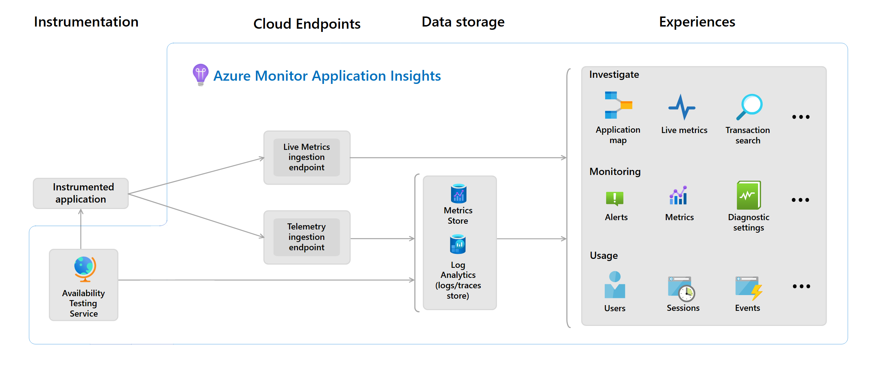
Logic model

Slide 25
What telemetry does Application Insights collect?
From server web apps:
HTTP requests.
Dependencies. Calls to SQL databases, HTTP calls to external services, Azure Cosmos DB, Azure Table Storage, Azure Blob Storage, and Azure Queue Storage.
Exceptions and stack traces.
Performance counters: Performance counters are available when using:
Azure Monitor Application Insights agent
Azure monitoring for VMs or virtual machine scale sets
Application Insights collectd writer.
Custom events and metrics that you code.
Trace logs if you configure the appropriate collector.

Slide 26
What telemetry does Application Insights collect?
From client webpages:
Uncaught exceptions in your app, including information on
Stack trace
Exception details and message accompanying the error
Line & column number of error
URL where error was raised
Network Dependency Requests made by your app XML Http Request (XHR) and Fetch (fetch collection is disabled by default) requests, include information on:
Url of dependency source

Slide 27
What telemetry does Application Insights collect?
From client webpages:
Command & Method used to request the dependency
Duration of the request
Result code and success status of the request
ID (if any) of user making the request
Correlation context (if any) where request is made
User information (for example, Location, network, IP)
Device information (for example, Browser, OS, version, language, model)
Session information

